Slide 1
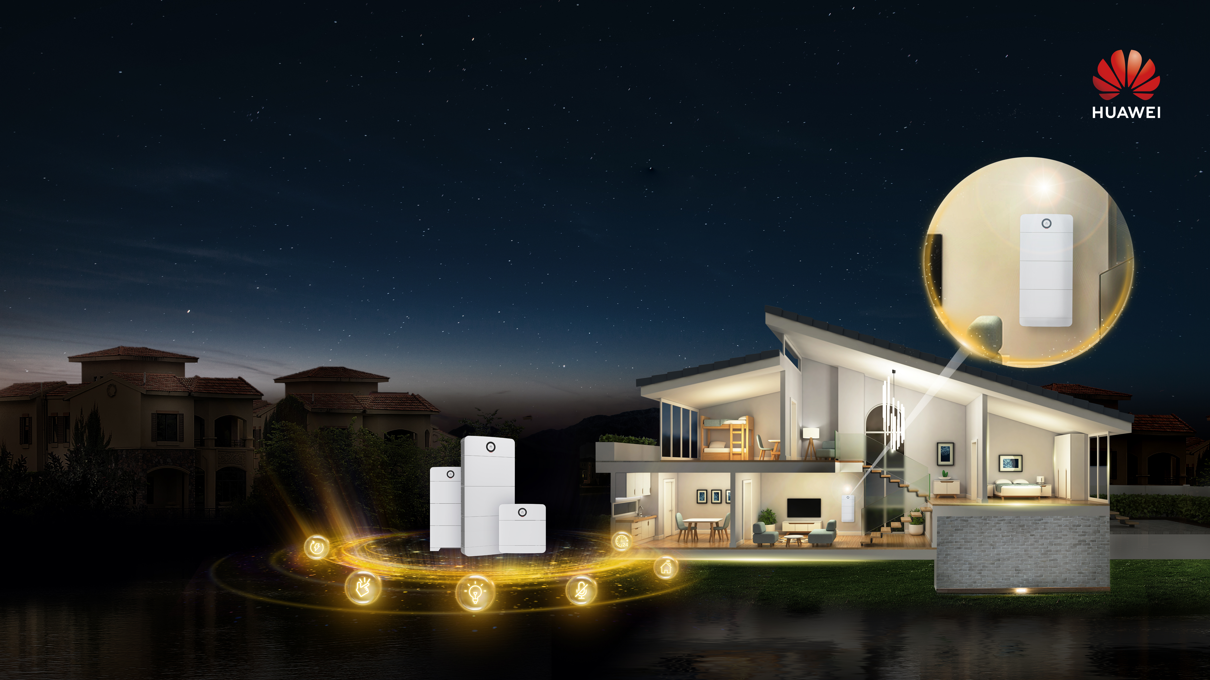
Power-M
High-quality Power Supply
Notes:
出差一周 冰箱

Slide 2
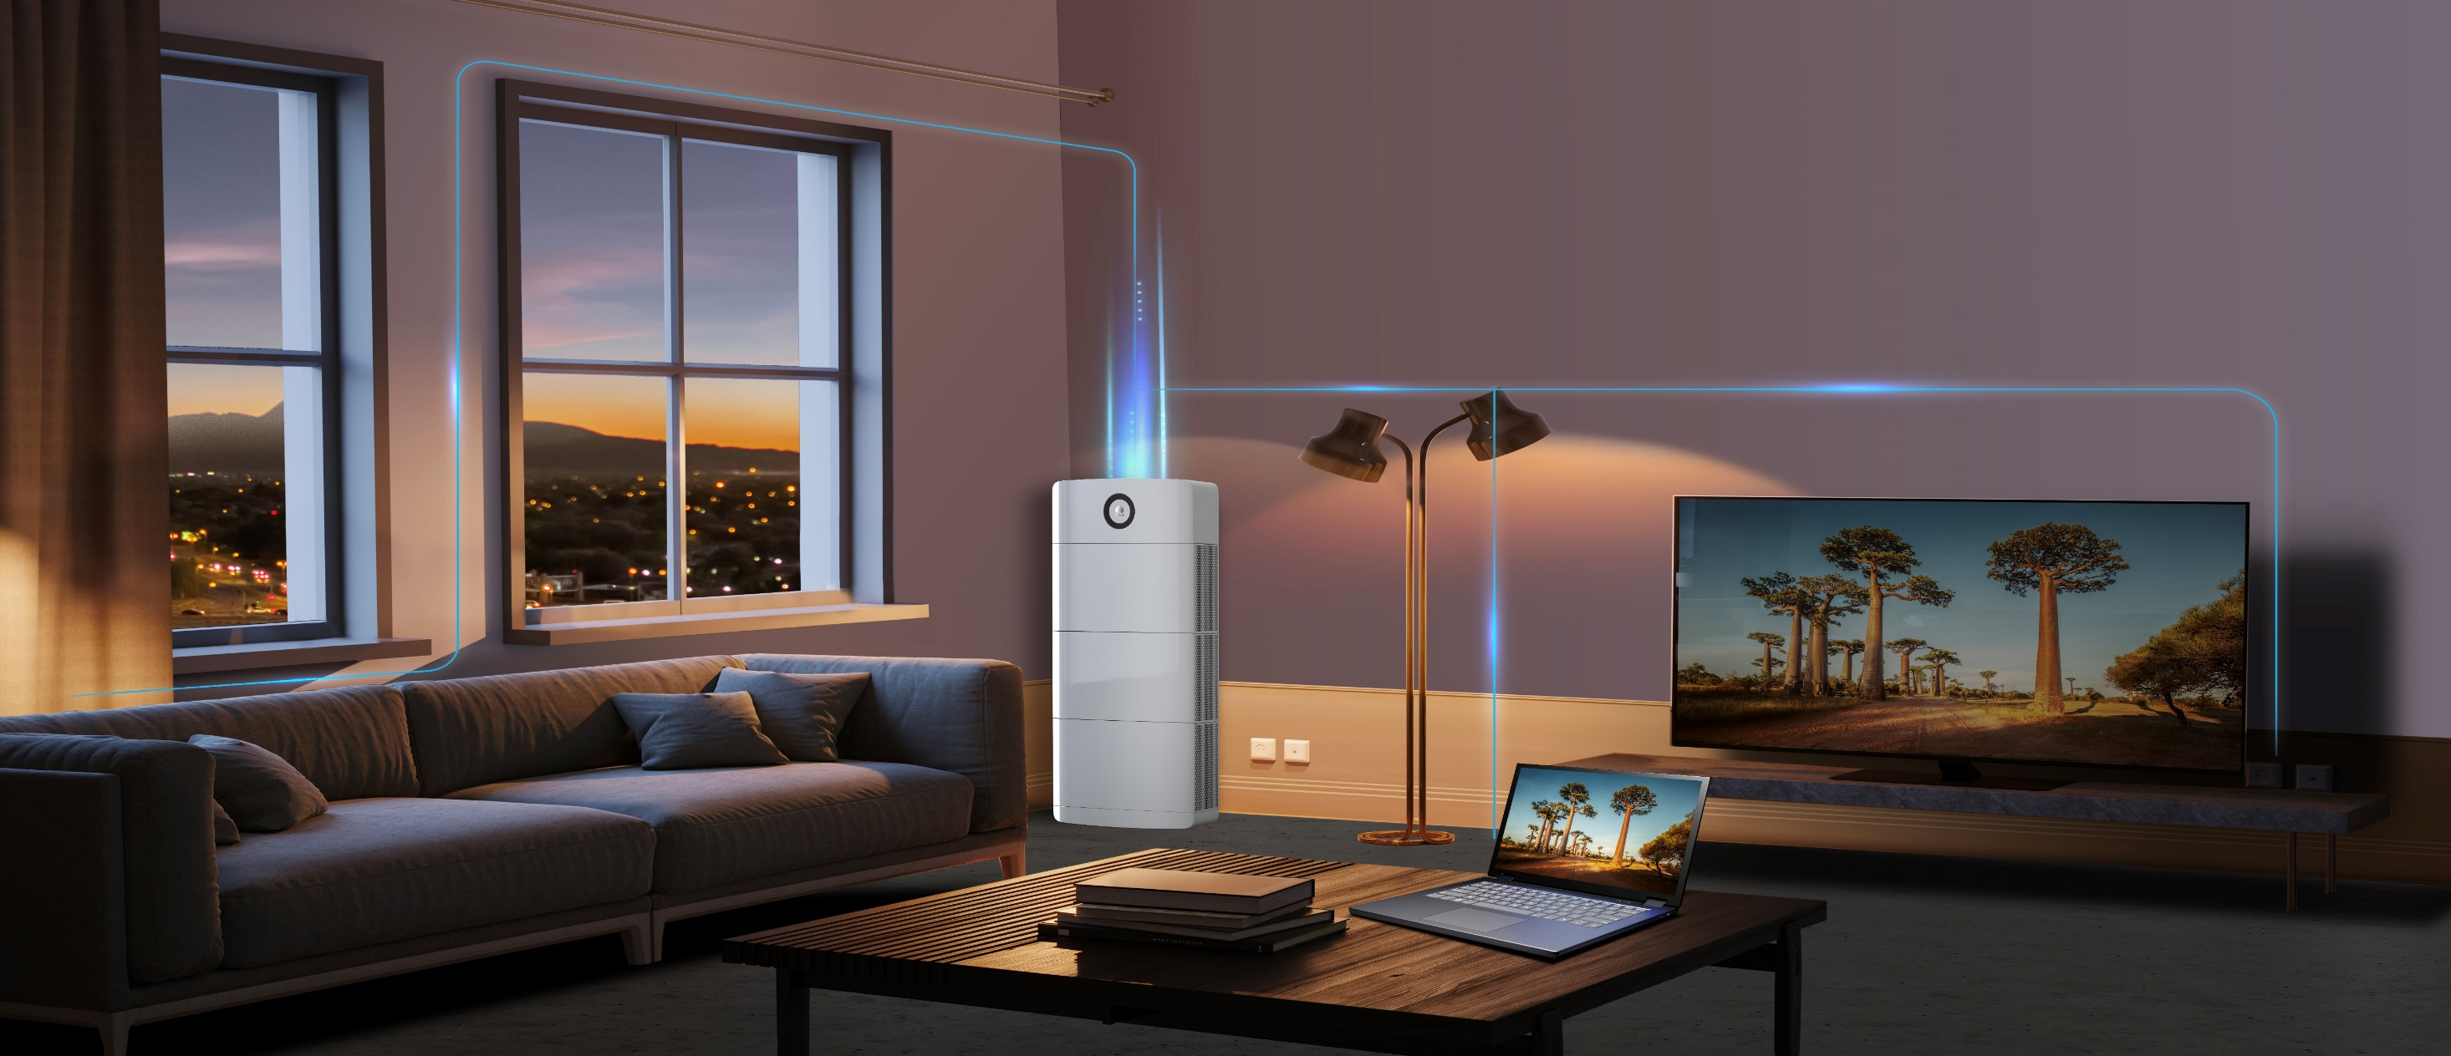
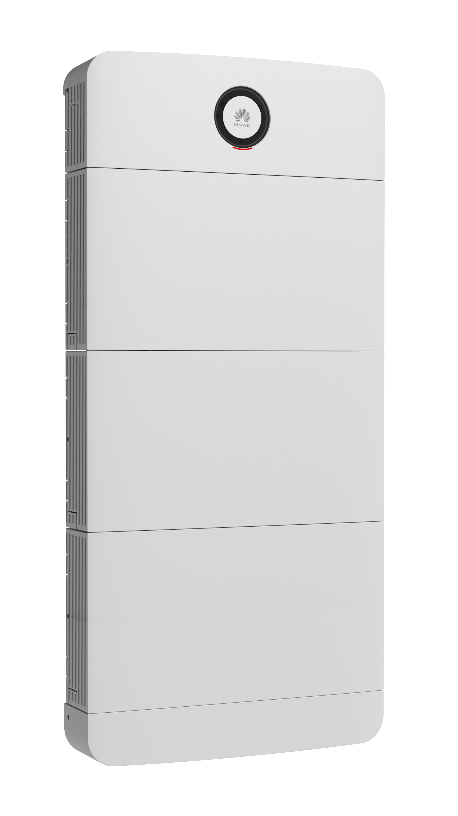
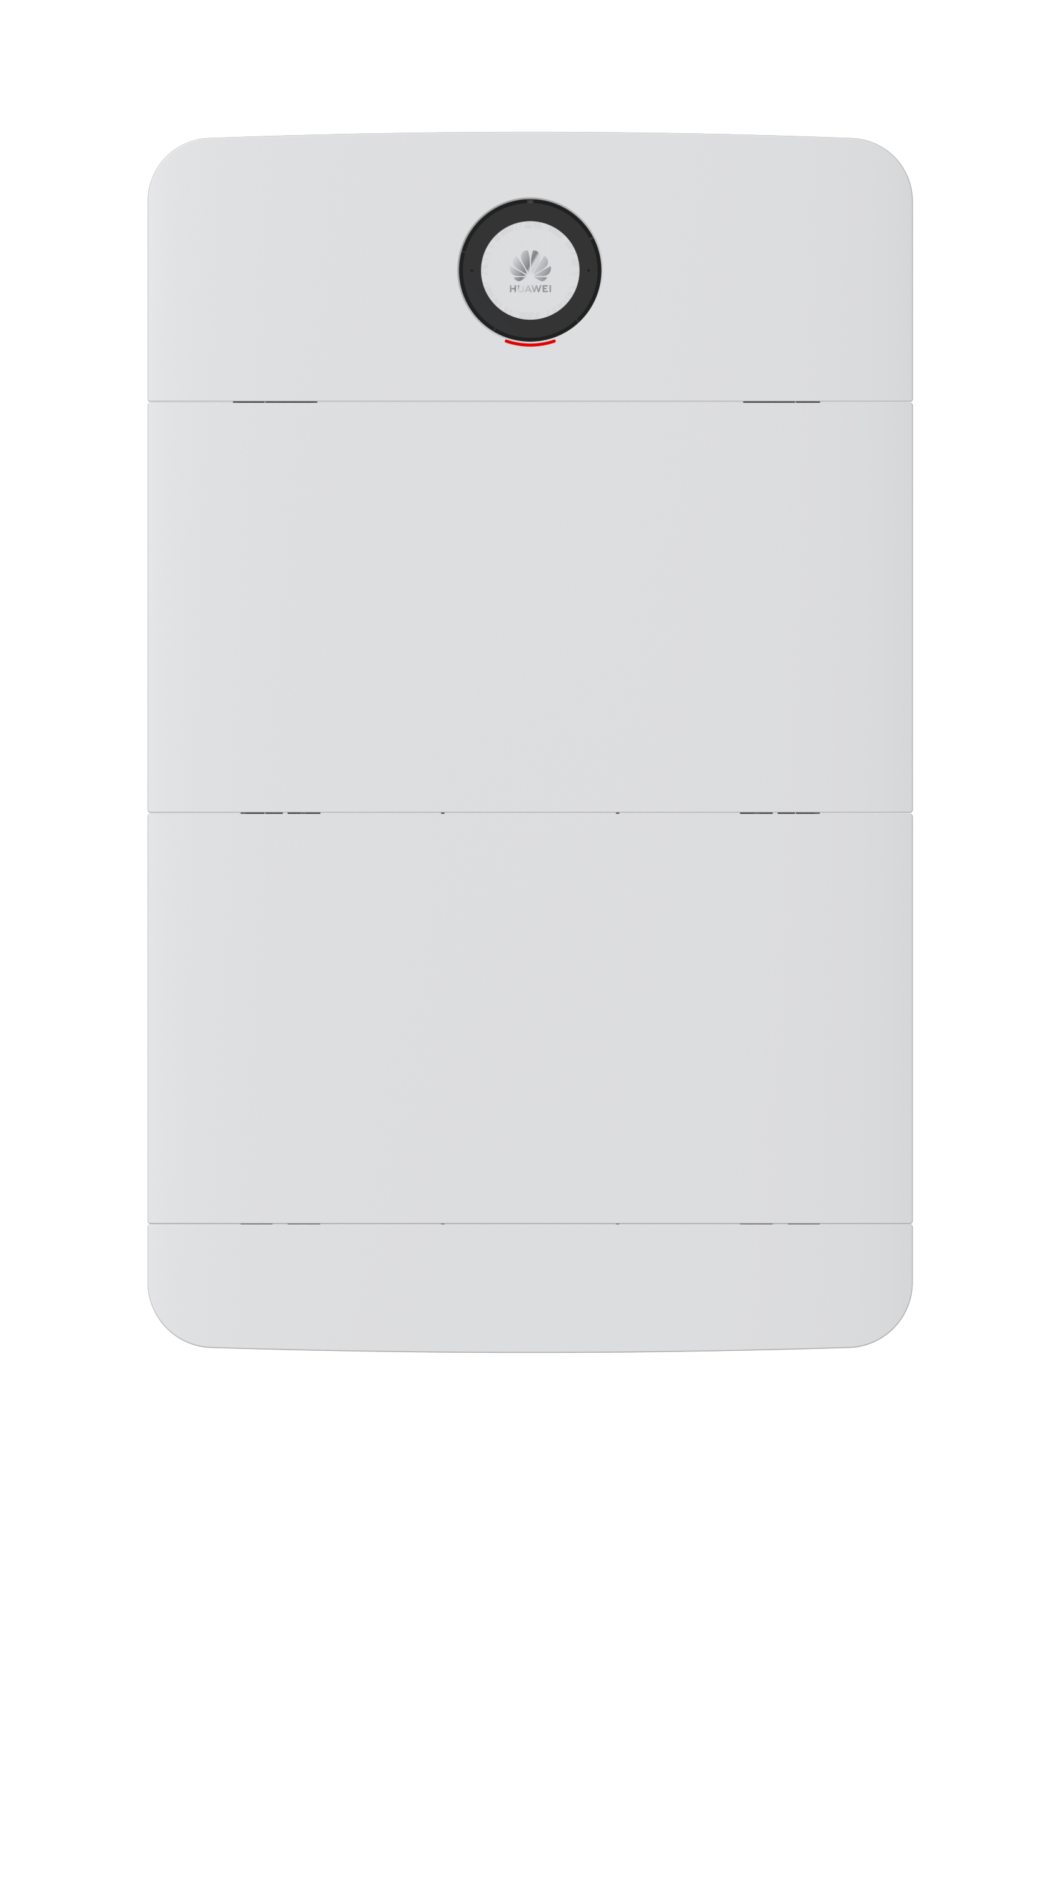
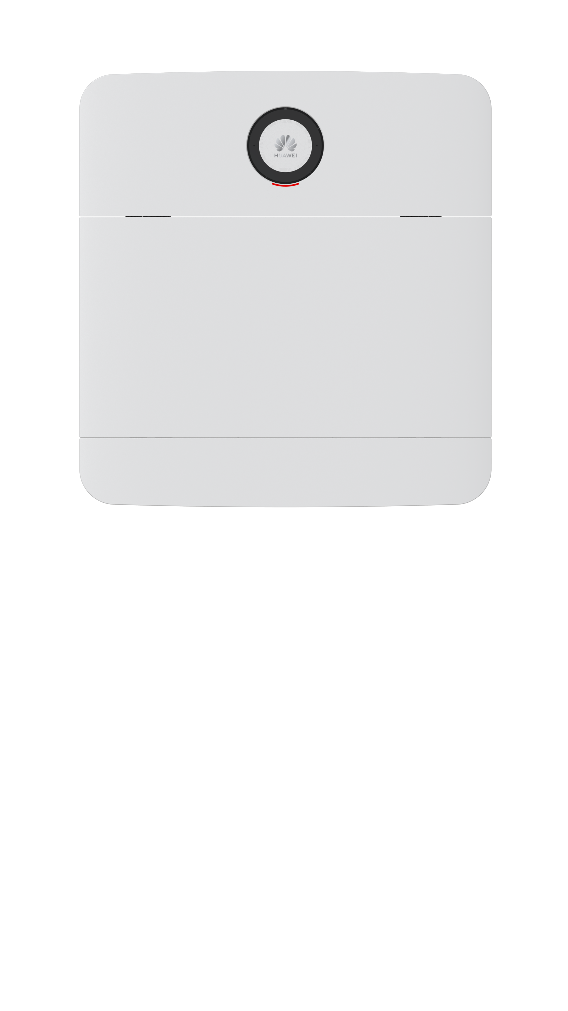
Power-M
High-quality Power Supply
Sleek Design
All-in-one and modular
Multi-scenario application
Sleep-grade noise
Seamless power switchover
Easy and Quick installation

Slide 3
Sleek Design
Aluminum alloy enclosure
Exquisite frosted texture

Slide 4
Apartment
House
Villa

Slide 5
Silent design
Matrix heat dissipation
No Fan
No Disturbance

Slide 6
Seamless power switchover
No Sense of Power Outage
＜0.02 seconds

Slide 7
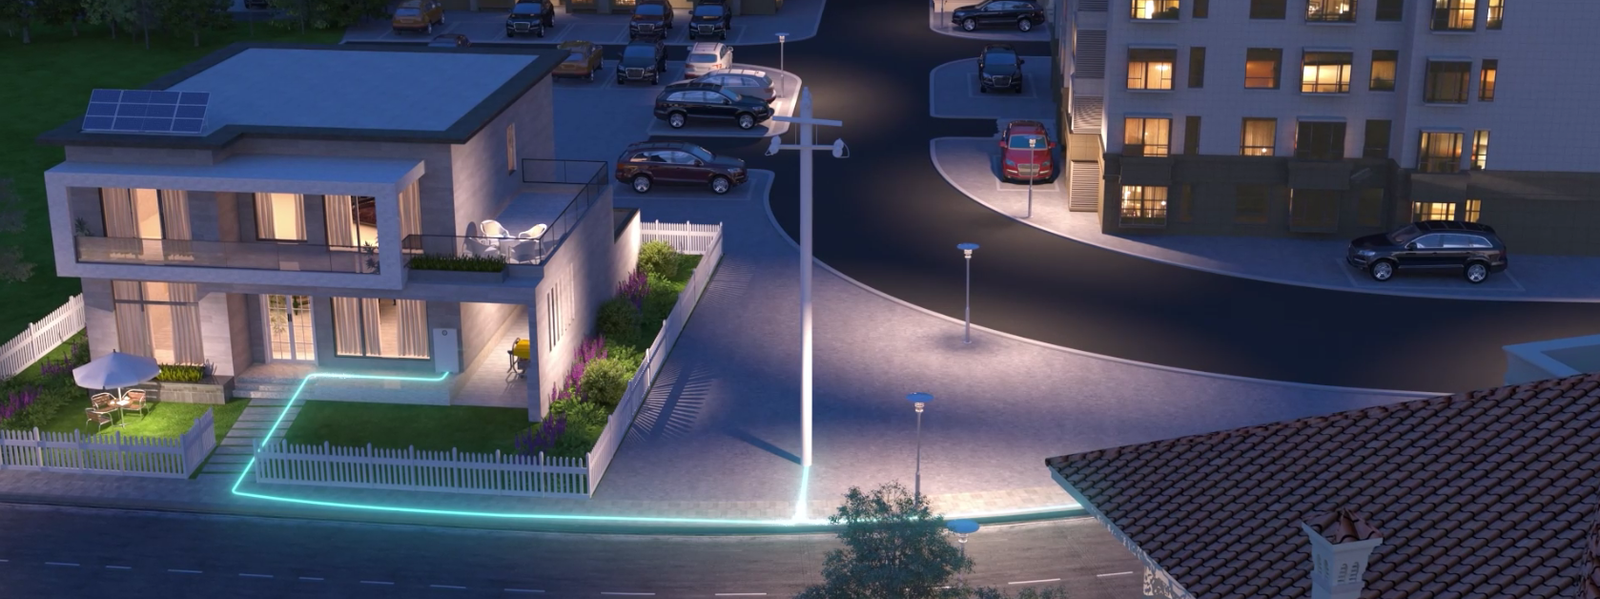
Solar ∣ Grid ∣ DG∣ Battery, Intelligent power management
Grid
Solar
DG
Priority
Solar
Grid
Battery
DG
Solar ∣ Grid ∣ DG ∣ Battery
Multi-energy access and scheduling
Photovoltaic power supply
Mains
Power supply
Battery discharge
Mains supply
Battery
charging

Slide 8
Easy and Quick Installation
Hidden Cables
1480mm
Plug and Play 2 hour installation
710 mm
690mm
165mm
Notes:
特性合并成三页

Slide 9
Recommended types of configuration
Scenario | Number of Power Modules | Number of Battery Modules | Power/Capacity of Battery Modules
1. Single-node system | 1 | 1 | 2.5kw/5kWh
 |  | 2 | 5kw/10kWh
 |  | 3 | 5kw/15kWh
 |  | 4 | 5kw/20kWh
 |  | 5 | 5kw/25kWh
 |  | 6 | 5kw/30kWh
2.5kw∣5kWh
5kw∣10kWh
5kw∣15kWh
5kw∣20kWh
5kw∣25kWh
5kw∣30kWh

Slide 10
Recommended types of configuration
Scenario | Number of Power Modules | Number of Battery Modules | Power/Capacity of Battery Modules
2. Parallel system | 2 | 2 | 5kw/10kWh
 |  | 4 | 10kw/20kWh
 |  | 6 | 10kw/30kWh
 | 3 | 3 | 7.5kw/15kWh
 |  | 6 | 15kw/30kWh
 |  | 9 | 15kw/45kWh
5kw∣10kWh
10kw∣20kWh
10kw∣30kWh
7.5kw∣15kWh
15kw∣30kWh
15kw ∣ 45kWh
Notes:
AC combiner box交流汇流箱

Slide 11
Excellent performance:
Ultra-fast: 3-hour fast charge 100%
Ultra-quiet: Fan less design, operating noise less than 29 dB
Energy switchover without perception<10ms
Smart priority management (Solar /battery /grid /DG)
Smart mobile APP management: monitor device running status in real time, help EPC & client efficiently manage device.
D.G. scheduling is supported, D.G. does not need to be started manually.
Built-in energy optimizer, supporting mixed use of old and new lithium batteries
Secure and Reliable:
90–300 V, withstand voltage jump
1.5 times the shock of the device startup current (air conditioner, washing machine, and motor)
0 Second Fast shut down (solar PV modules’ voltage can be quickly shut down to 0 V within 0s，Ensure the safety: the owner, installation and maintenance personnel)
IP65 dustproof & waterproof ( indoor /outdoor)
Matrix Design Heat Dissipation
AFCI function
Most stable LFP Battery, no fire risk
Battery built-in full-dimensional high-precision sensors

Slide 12
Power-M VS other products
Bettery performance
No need to start D.G manually
Smart priority manage (Solar /grid /battery /DG)
D.G scheduling
noiseless <29 dB
Ultra-quiet: Sleep level
1. Don’t support D.G scheduling
2. Don’t support
Power failure is likely to occur in frequent short-term power outages
4. Some of its can not sustain over 2years
√
√

Slide 13
Power-M VS other products
Bettery performance
√
3 hours Fast Charging 100%
1. Don’t support Fast Charging
2. Lead-acid batteries are often used,
battery cycle performance is insufficient.
Power failure is likely to occur in frequent short-term power outages
4. Some of its can not sustain over 2years
√
LFP Battery
Lithium iron phosphate
Stable & No Fire Risk
Cycle life: 6000 times
√
√

Slide 14
Power-M VS other products
Bettery performance
Battery built-in high-precision sensors
Smart monitor Battery
Status in real time
New and old lithium batteries support work together
√
New and old lithium batteries are not supported Resulting in: High capacity expansion Costs.
√
√

Slide 15
Power-M VS other products
Cost Compare
No local team at all
If repair has to ship it to abroad headquarters
No local Spare parts in stock
Higher Repair/Maintenance Cost
Cycle life does not last long Some clients buy new battery/part
after 2 years only
5 years Warranty
Nigeria Local after-sales+technical Team
Nigeria Local Spare Parts in stock
Low Repair/Maintenance Cost
Smart manage system
Low O&M Cost
√
√

